Slide 1
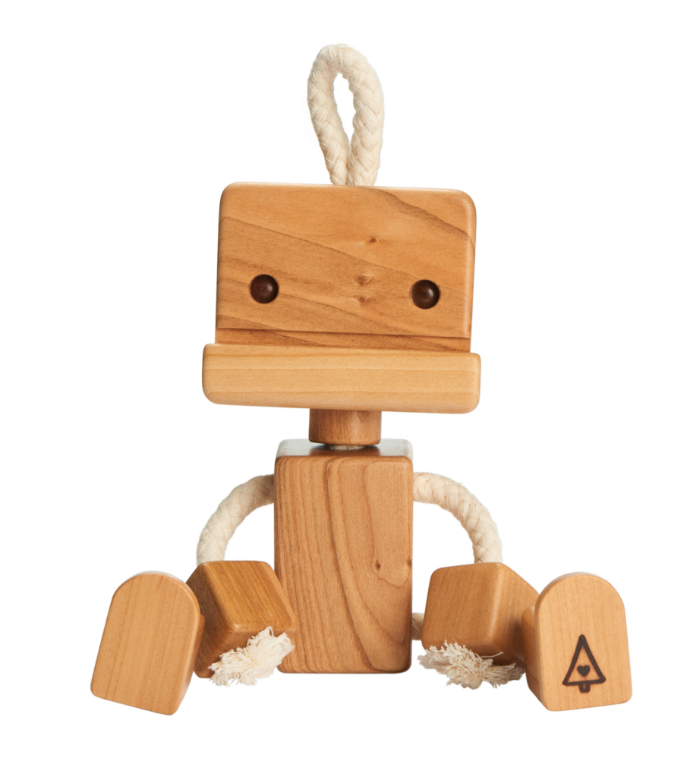

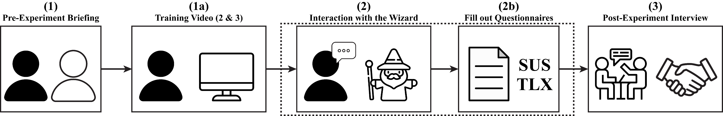
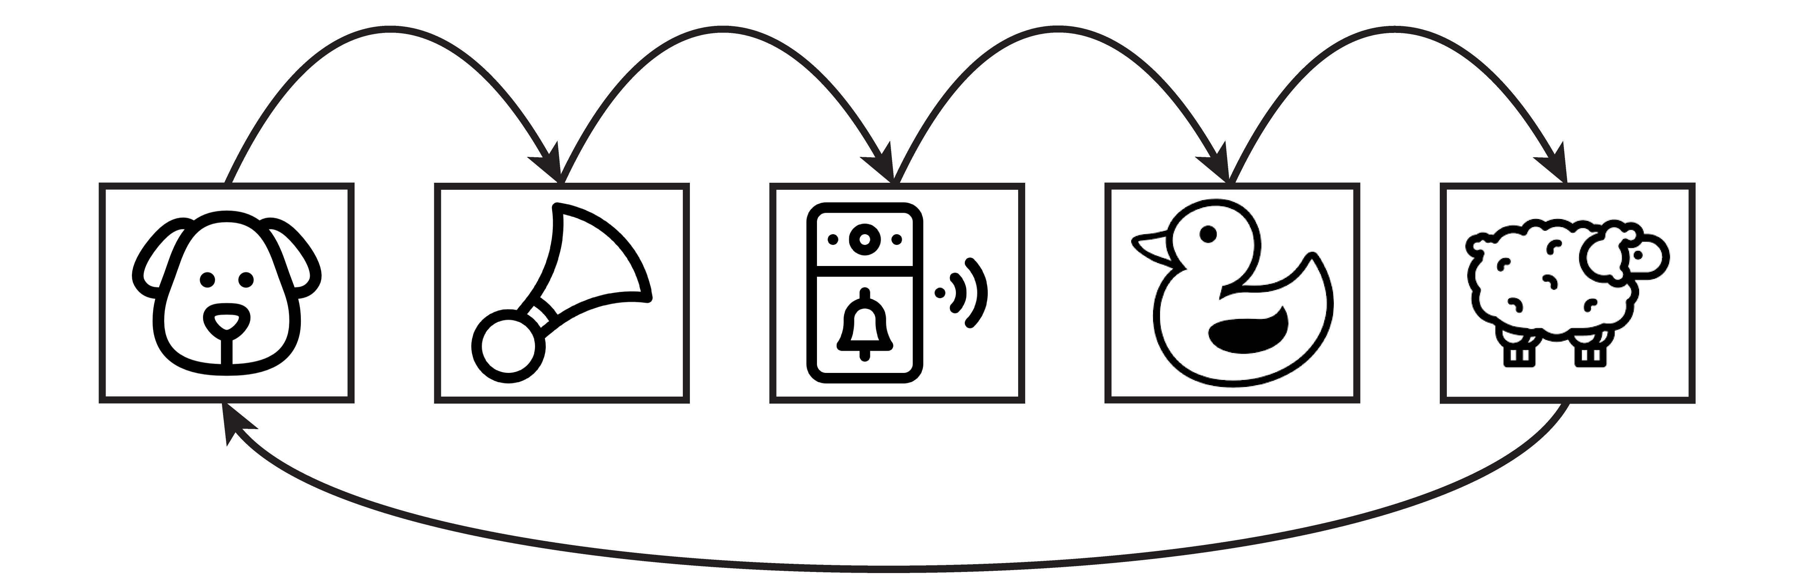
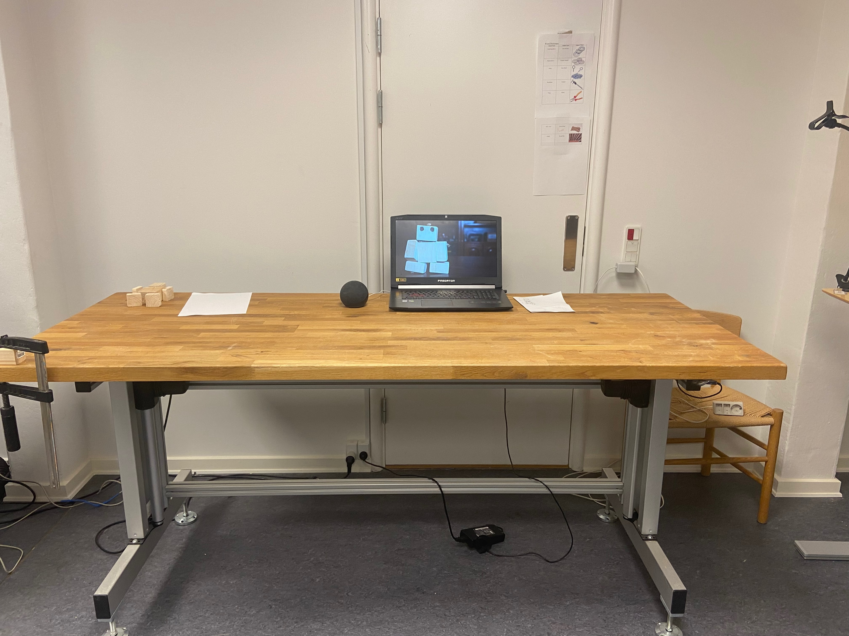

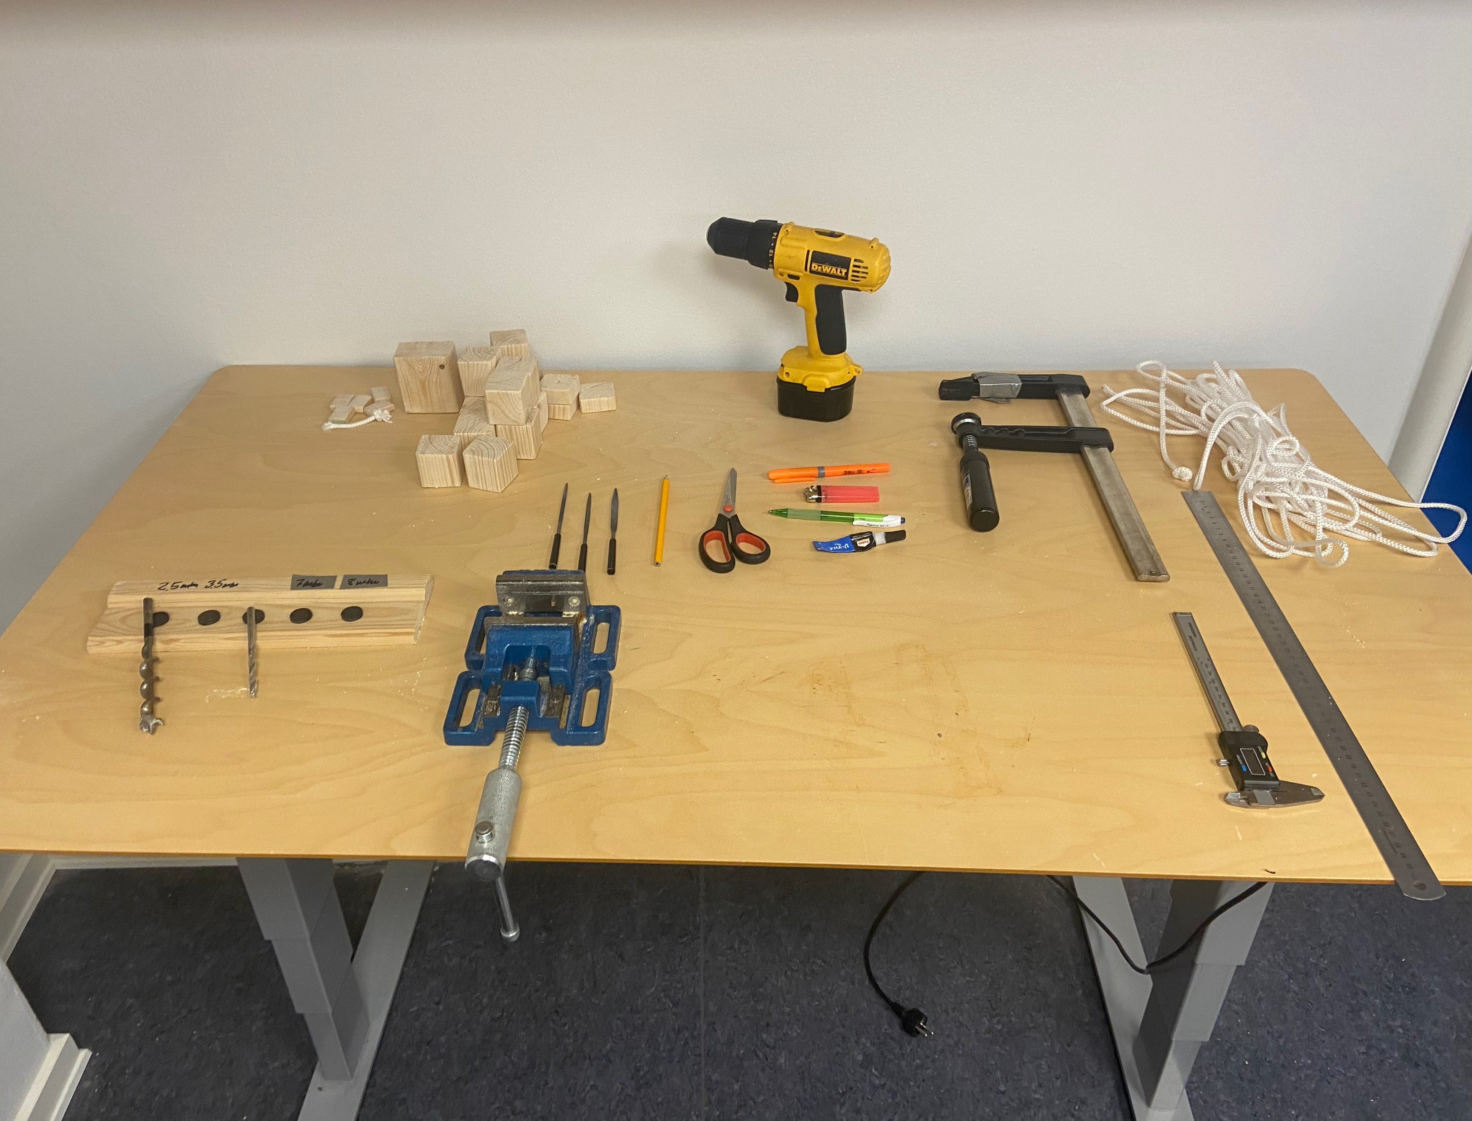
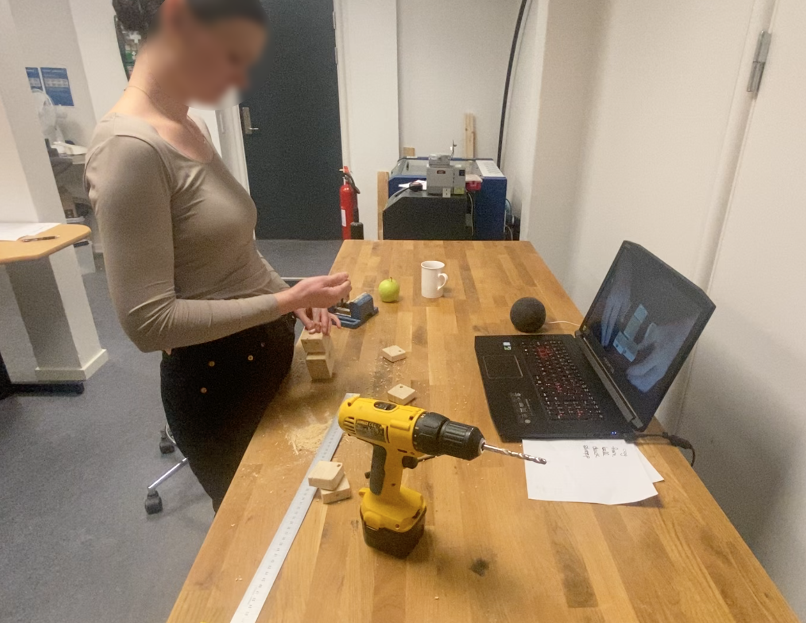
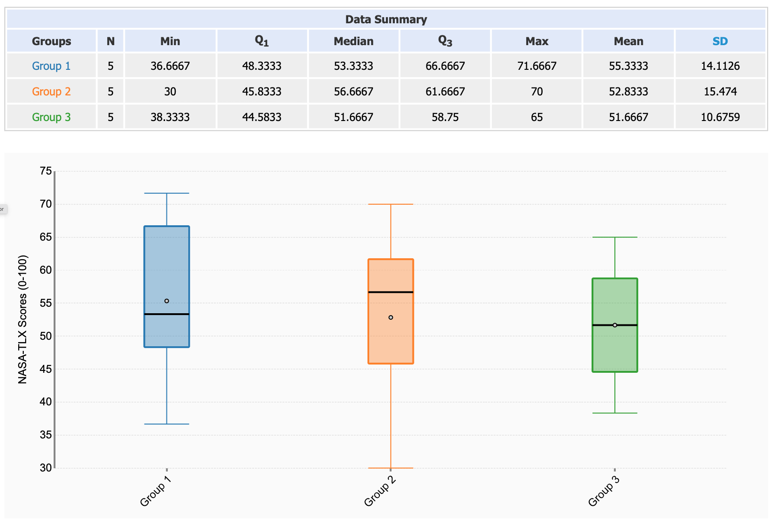
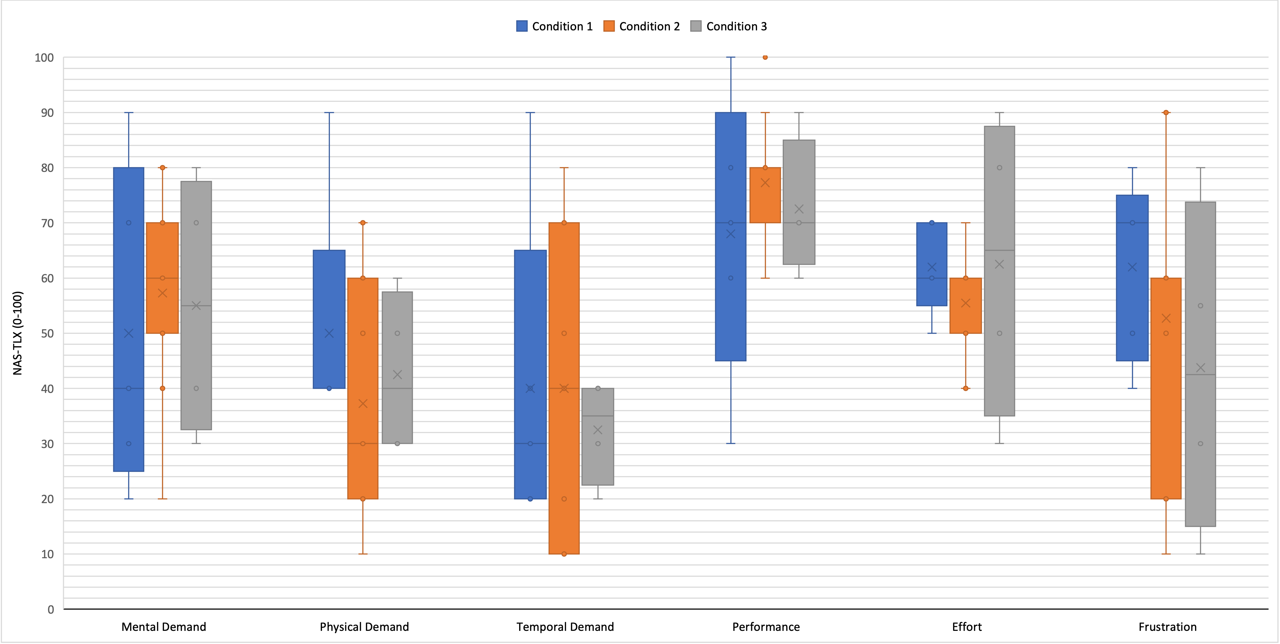
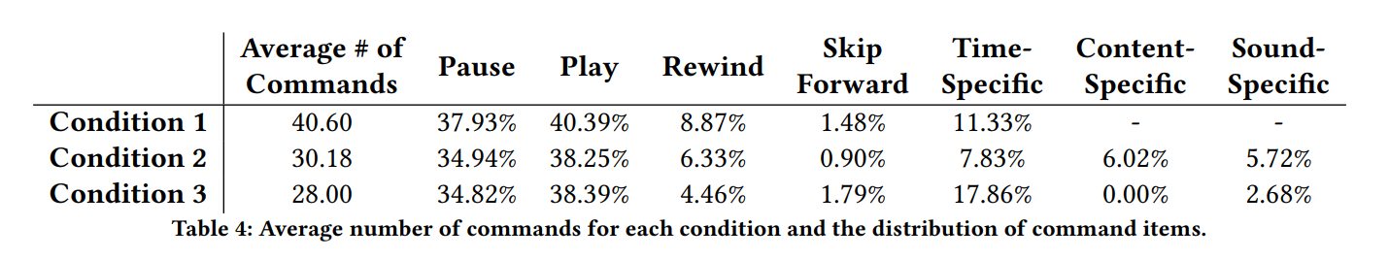
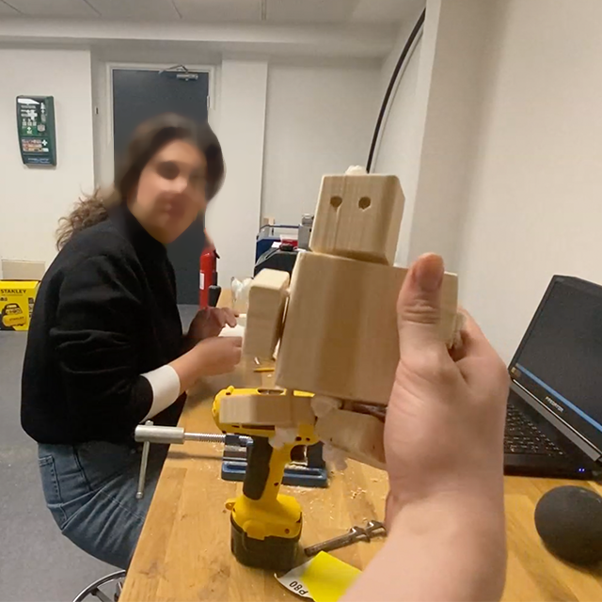
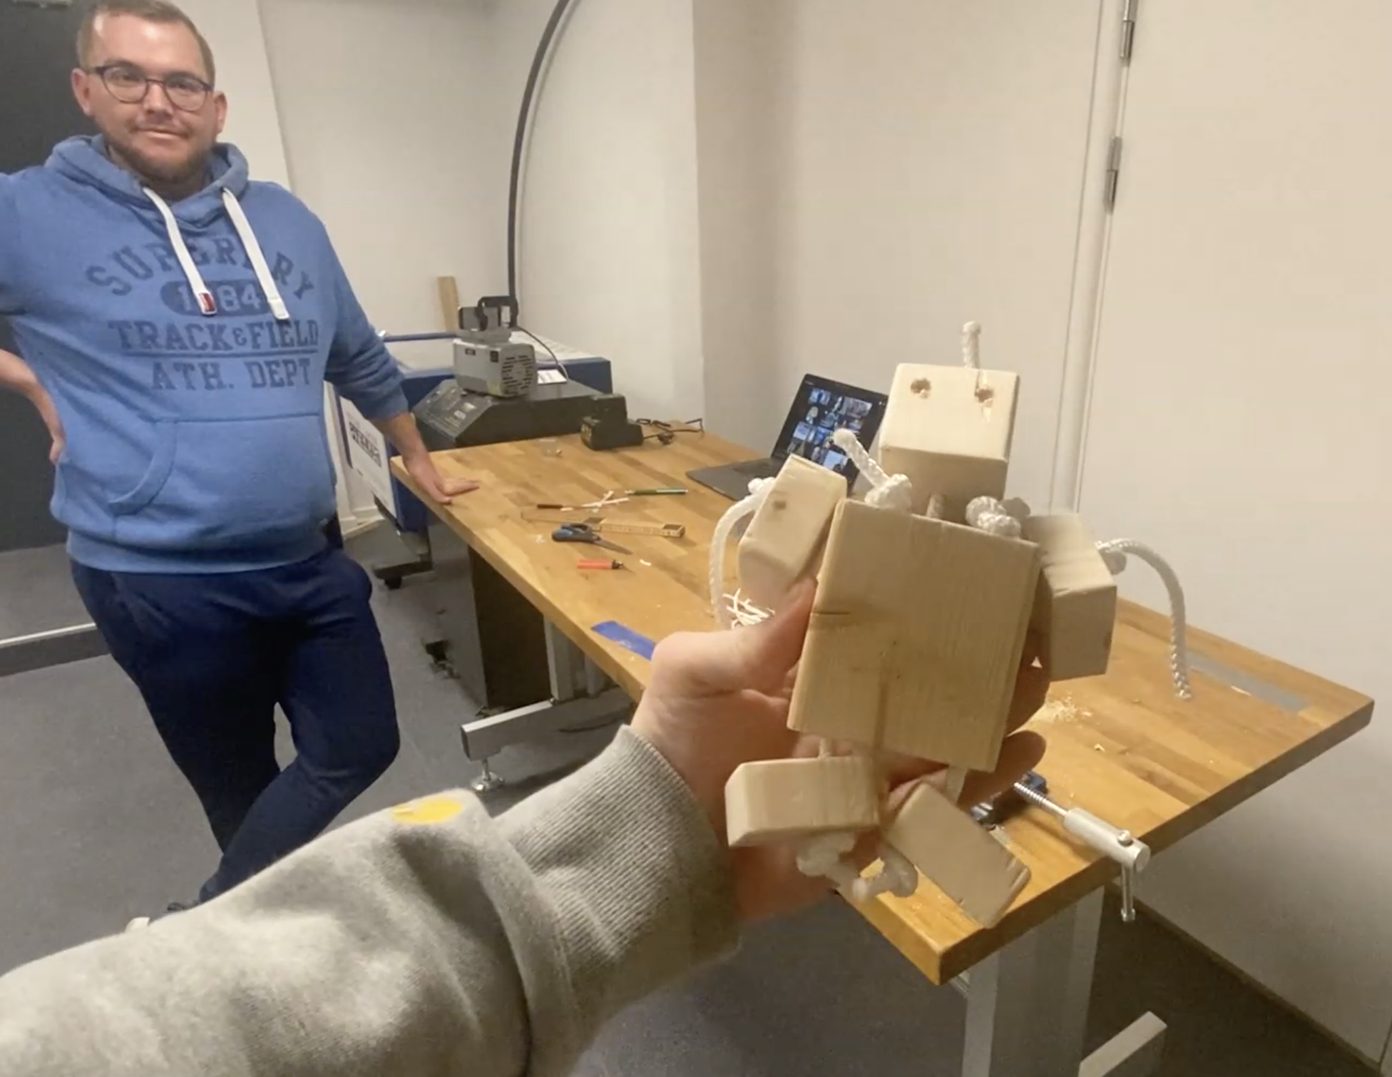
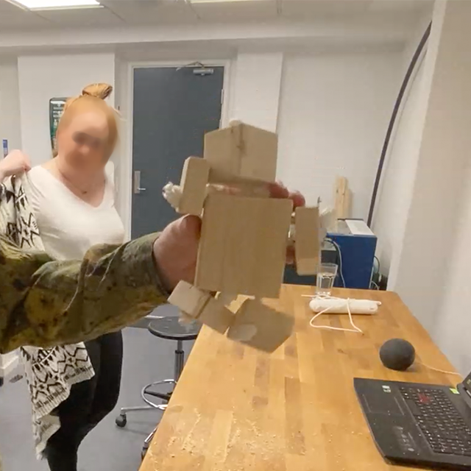
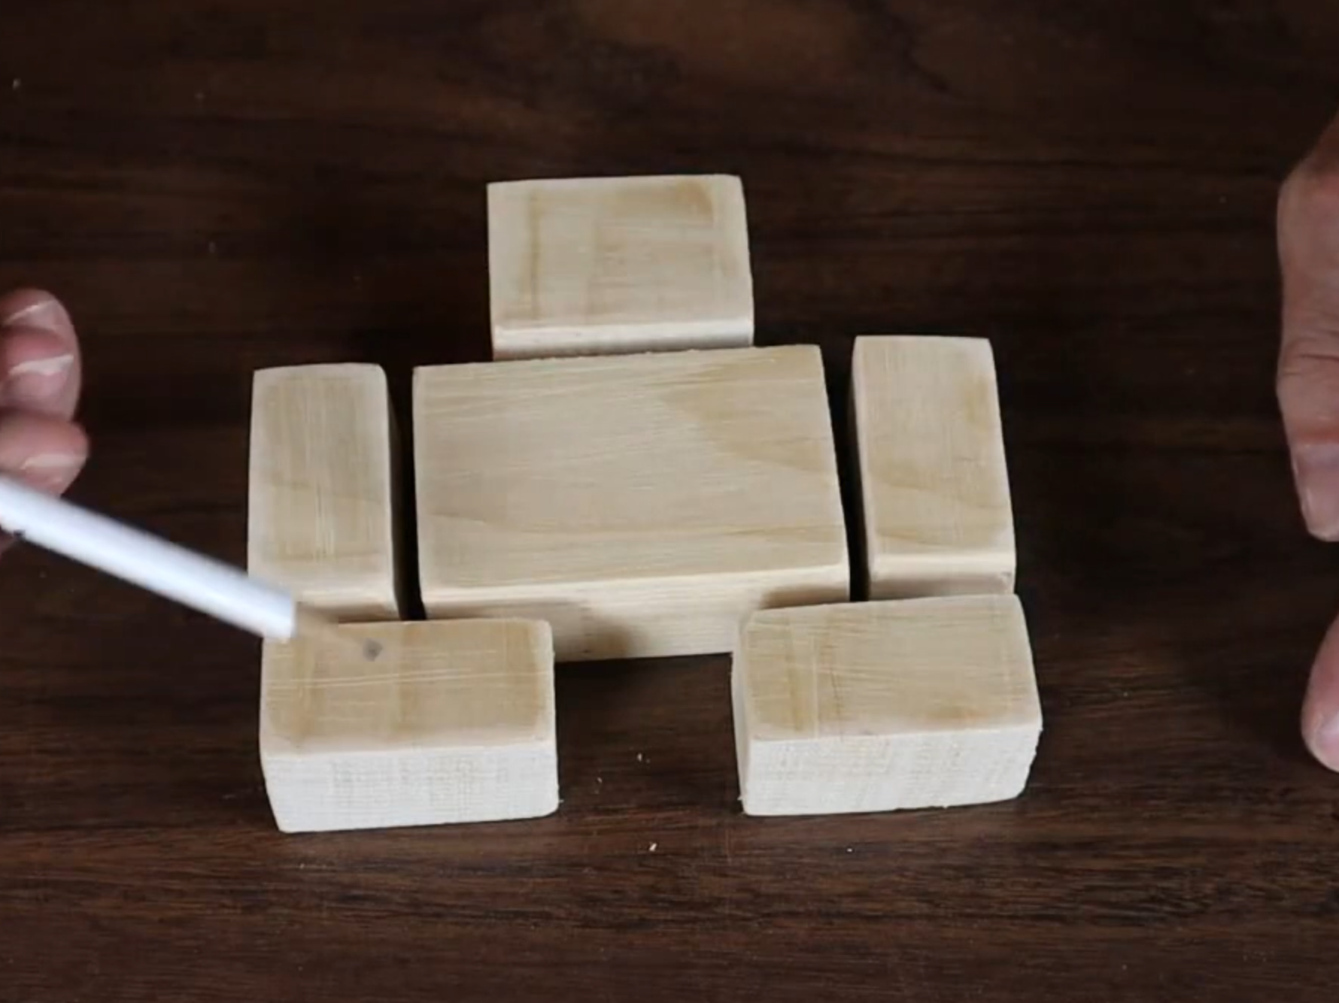
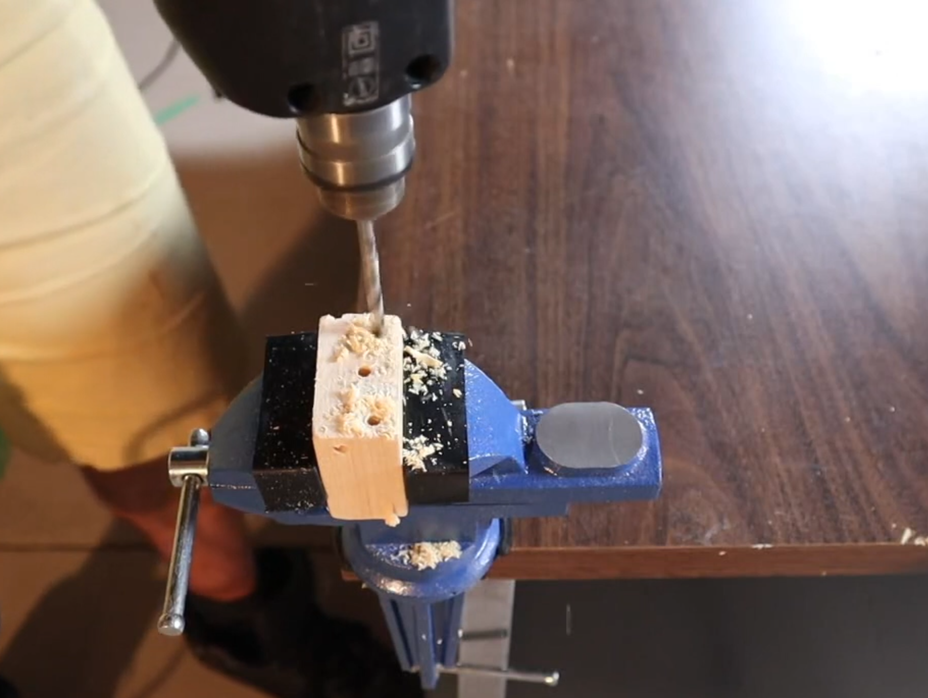
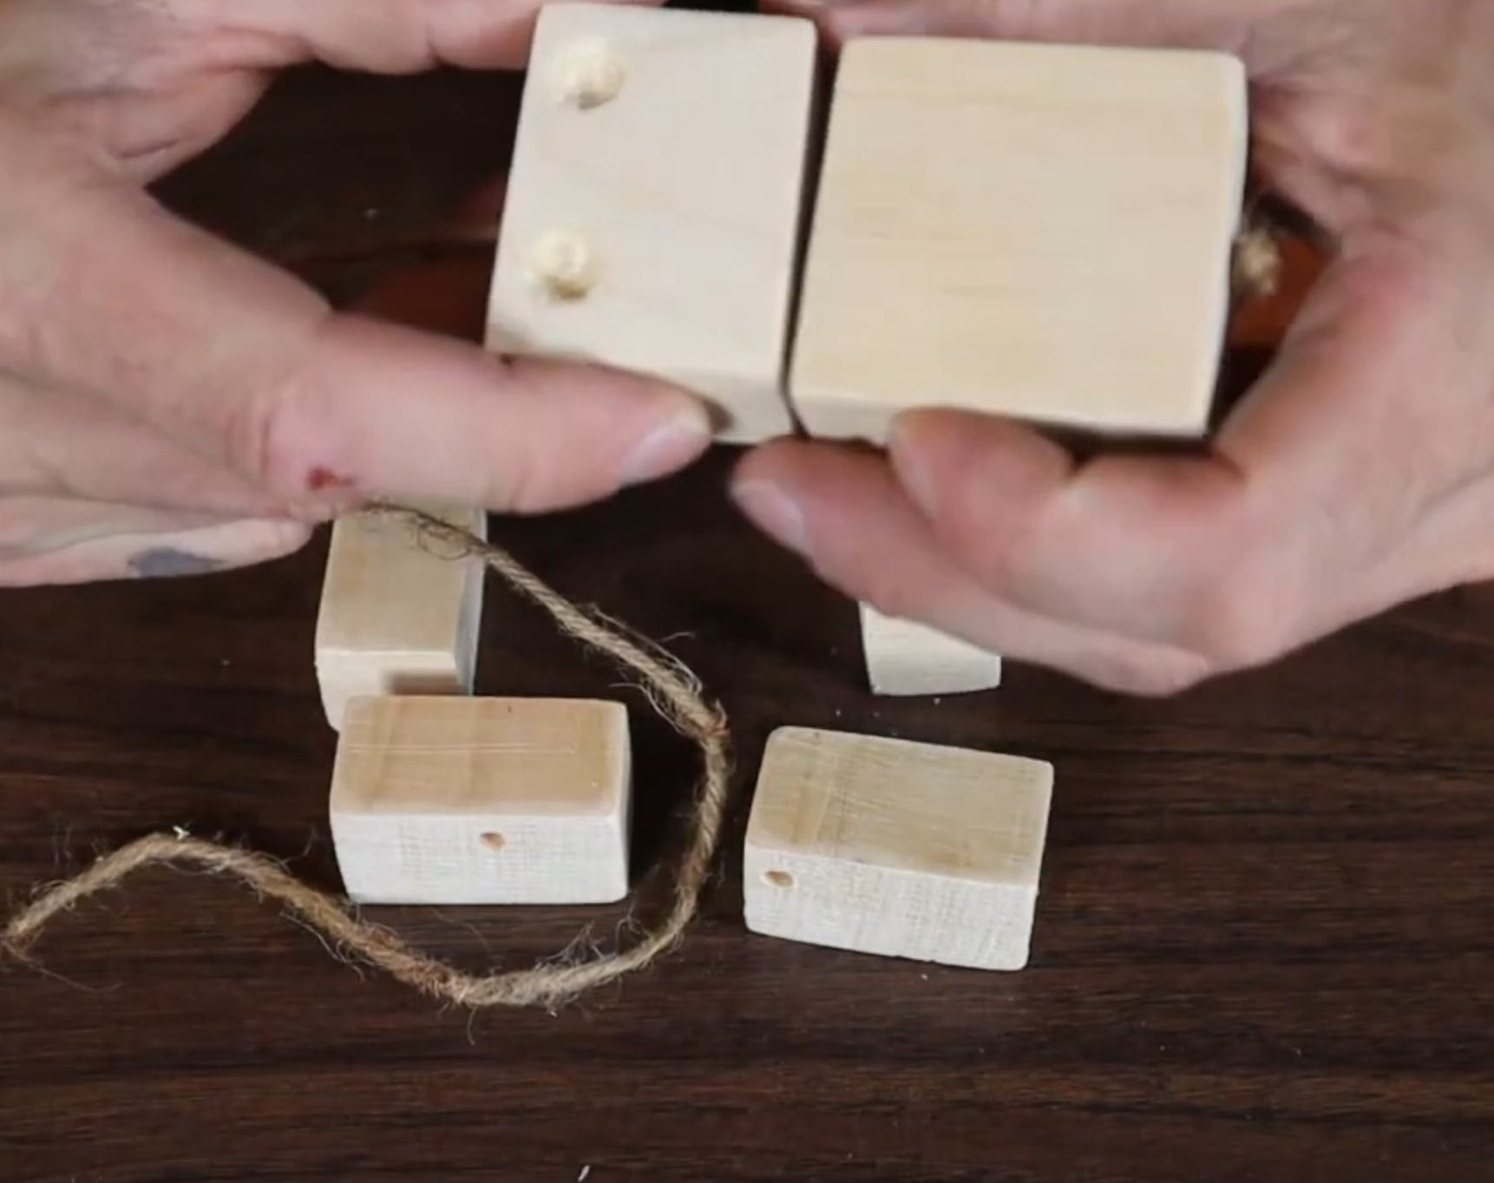
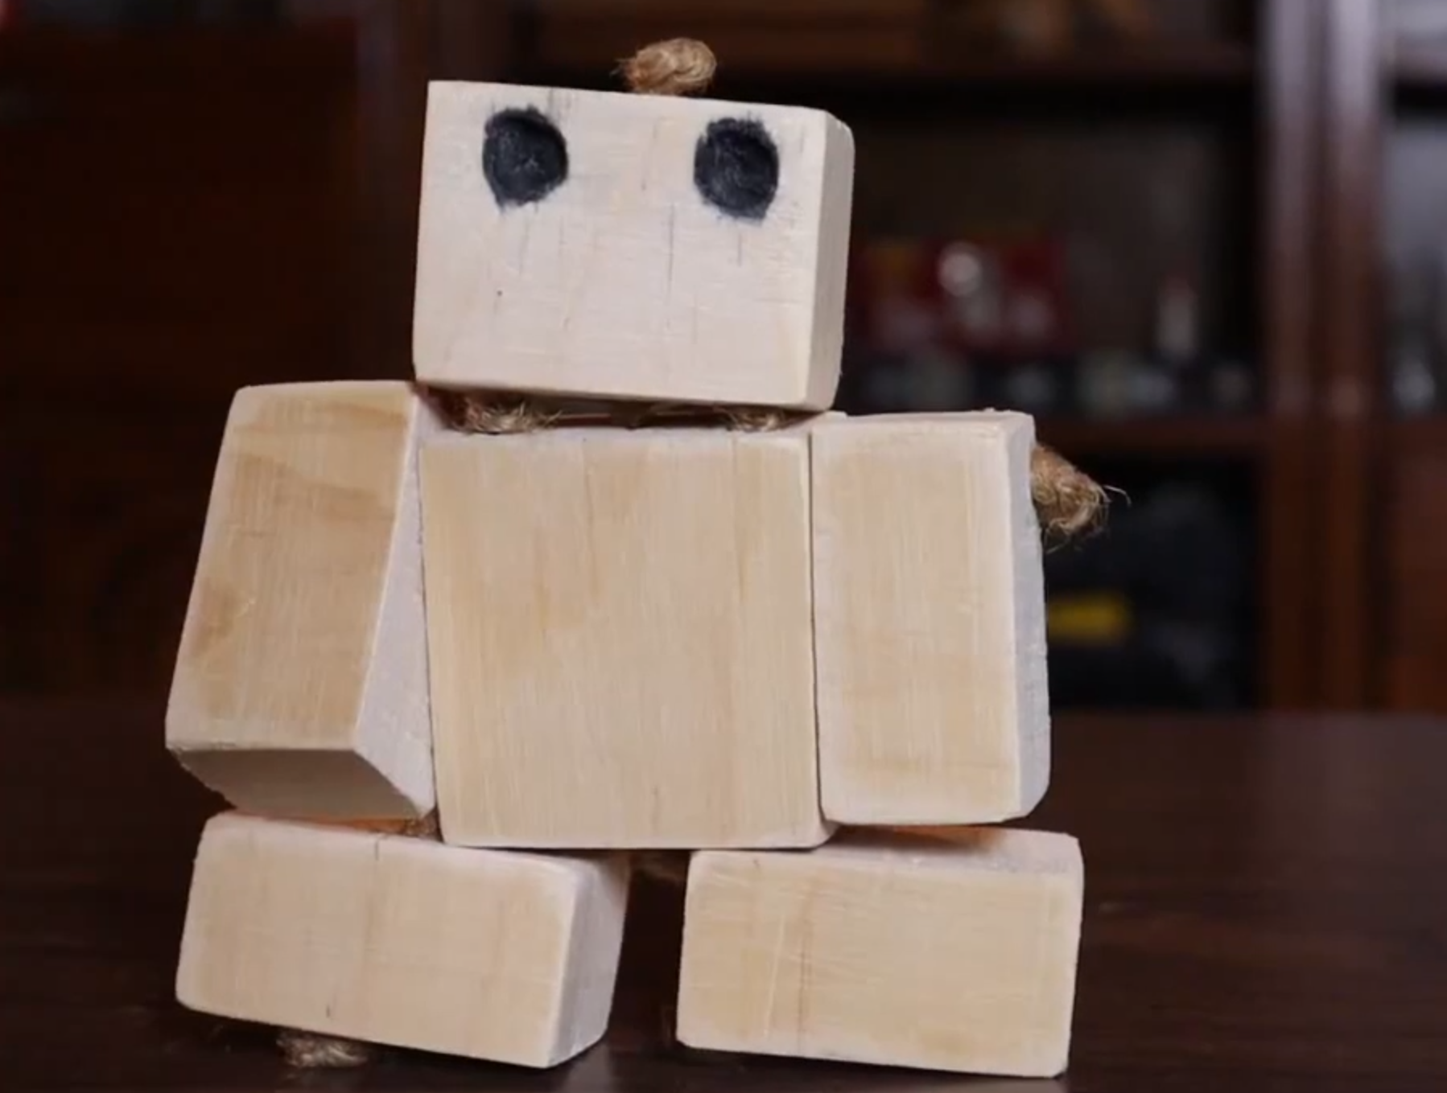
Exploring Audio Icons for Content-Based Navigation in Voice User Interfaces
Jonas Kjeldmand Jensen & Daniel Ashbrook
Human-Centred Computing Research Section, Copenhagen University
Introduction
Study Overview
Contributions
Online how-to videos are popular for learning physical tasks, but current videos lack voice interaction support.
Voice interaction can enhance the learning experience by allowing users to stay focused and hands-on while navigating video content.
Augmented voice playback control features, such as audio icons, have the potential to enhance voice navigation in instructional videos.
User study on auditory cues as feedback mechanisms for highlighting events in voice-based navigation.
Prototype of a hybrid voice interaction system combining temporal and content-based referencing.
Future research and design opportunities for voice-based non-linear video control.
Audio Icons
Study Protocol
Research Questions RQ1: Can audio icons improve video navigation in how-to videos? RQ2: What are the challenges and opportunities for designing voice navigation in instructional videos?
Icons appeared 19 times in the how-to video
Sequence of five recurring sounds: dog bark, car horn, doorbell, duck quack, sheep bleat
Each audio icon associated with multiple action points
Participants were tasked with assembling a wooden robot with a how-to video while using a voice-controlled navigation system that responded to time- and content-based voice commands.
Performance, usability, and perceived workload were assessed using questionnaires and interviews to evaluate participants' interaction with the video tutorial using voice commands.
Results and Conclusion
Significant difference in usability (SUS) between audio icons at action points vs. baseline condition.
Participants reported having a positive experience with voice-based playback control, finding it flexible and helpful.
Audio icons improved voice navigation of how-to videos, resulting in faster task completion, fewer voice commands, and higher SUS scores.
Participants expressed that the abstraction of meaning between the audio icons and video content hindered effective utilization.
Methods
Experimental Design
Utilized a WoZ between-participant design
Independent variable
Augmented navigational audio icon features
Measures
Objective measures: Task completion time, number, and types of commands
Post-task questionnaires: Usability (SUS) and cognitive workload (NASA-TLX)
Semi-structured interviews: Feedback and suggestions for improvement
Participants
24 participants (15 male, 9 female)
Statistical analysis
One-way ANOVA followed by Tukey's HSD post hoc test (α = 0.05)
Study Conditions
Study Conditions | Comditions
Condition 1 | Baseline condition with TV remote-like voice control features
Condition 2 | Five-audio icon sequence played in conjunction with key points-of-action in the video
Condition 3 | Audio icons played at fixed 30-second intervals, serving as landmarks throughout the video
Experiment Steps

